Slide 1
تراشه ها ي منطقي برنامه پذ ير

Slide 2
مدارهاي ديجيتال
S

Slide 3
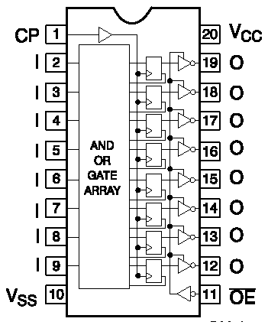
Simple PLD (SPLD)
براي پياده سازي مدارهاي ترتيبي معمولا در خروجي، FF قرار دارد.
PAL 16R8

Slide 4
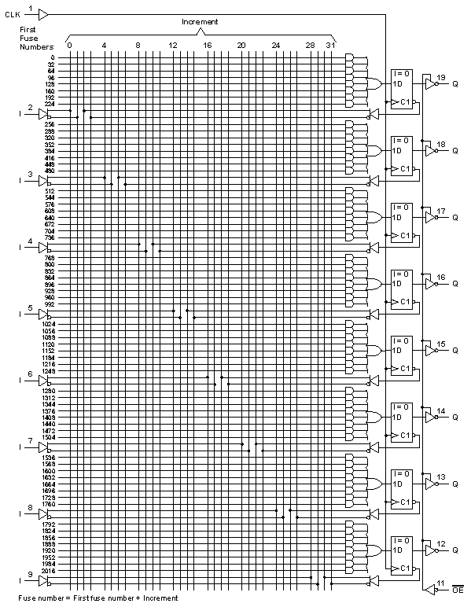
PAL 16R8

Slide 5
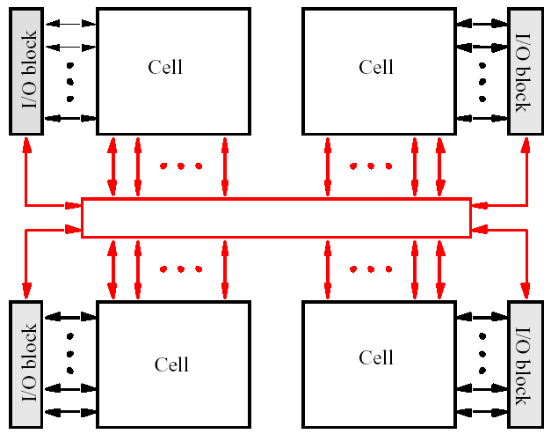
CPLD
Interconection Wires

Slide 6
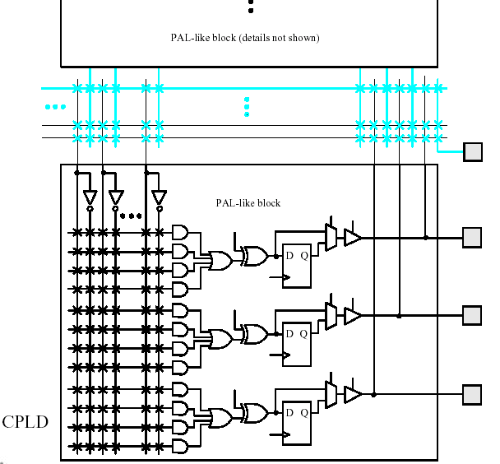
بخشي از CPLD

Slide 7
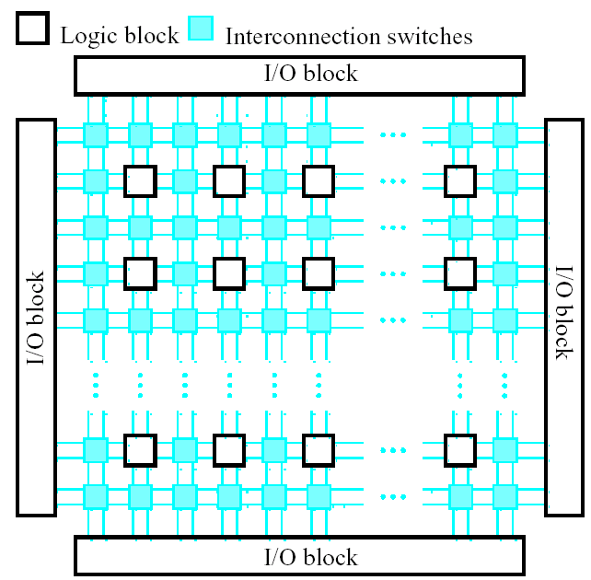
ساختار FPGA

Slide 8
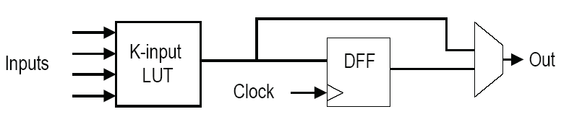
Logic Cell
LUT: Lookup Table
Flip-flop: typically DFF (in some devices programmable into D-latch or TFF)

Slide 9
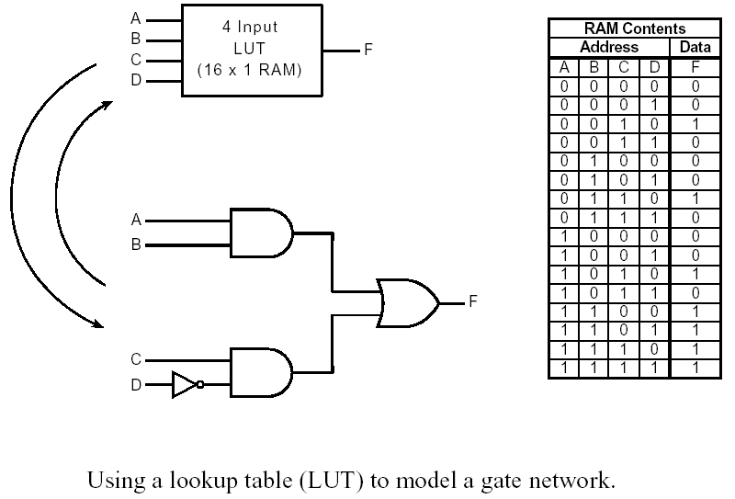
LUT
Bitstream: 0010001000101111

Slide 10
Another Type of Logic Cell
LUT
Combinational Output
DFF
Sequential Output
Clk

Slide 11
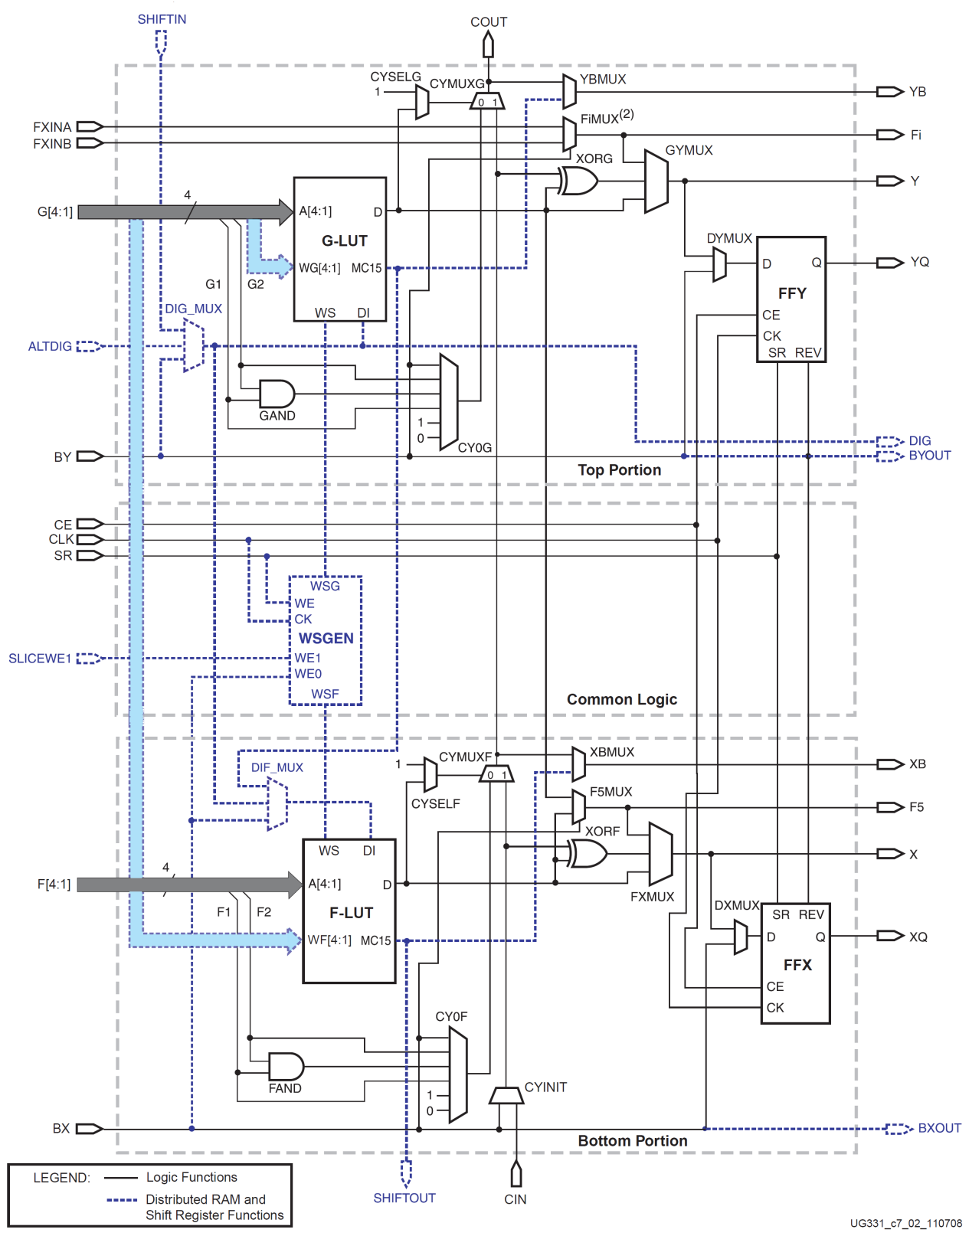
Logic Cell نمونه
Spartan Logic Cell

Slide 12
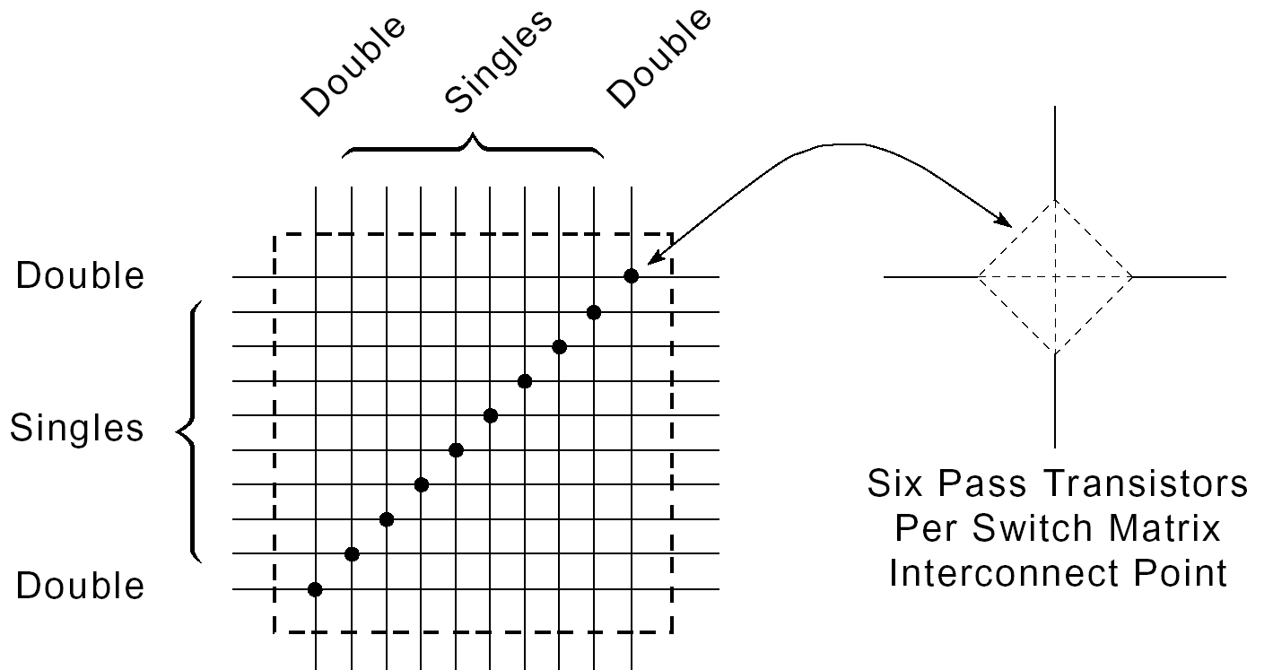
Programmable Switch Matrix (PSM)
SRAM cells: contents in the bitstream

Slide 13
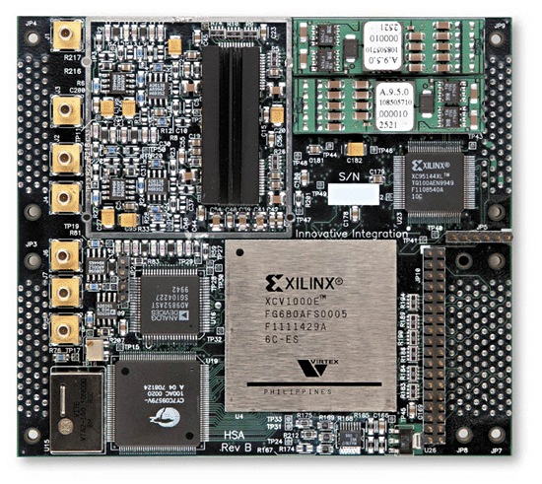
SRAM-Based FPGA
Programmable Lookup Tables (LUTs)
Programmable routing structure
[Entegra]

Slide 14
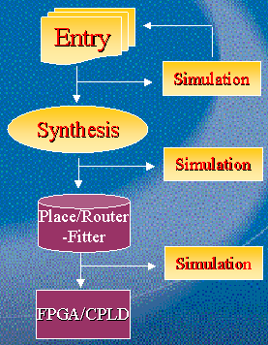
Design Cycle for FPGAs

Slide 15
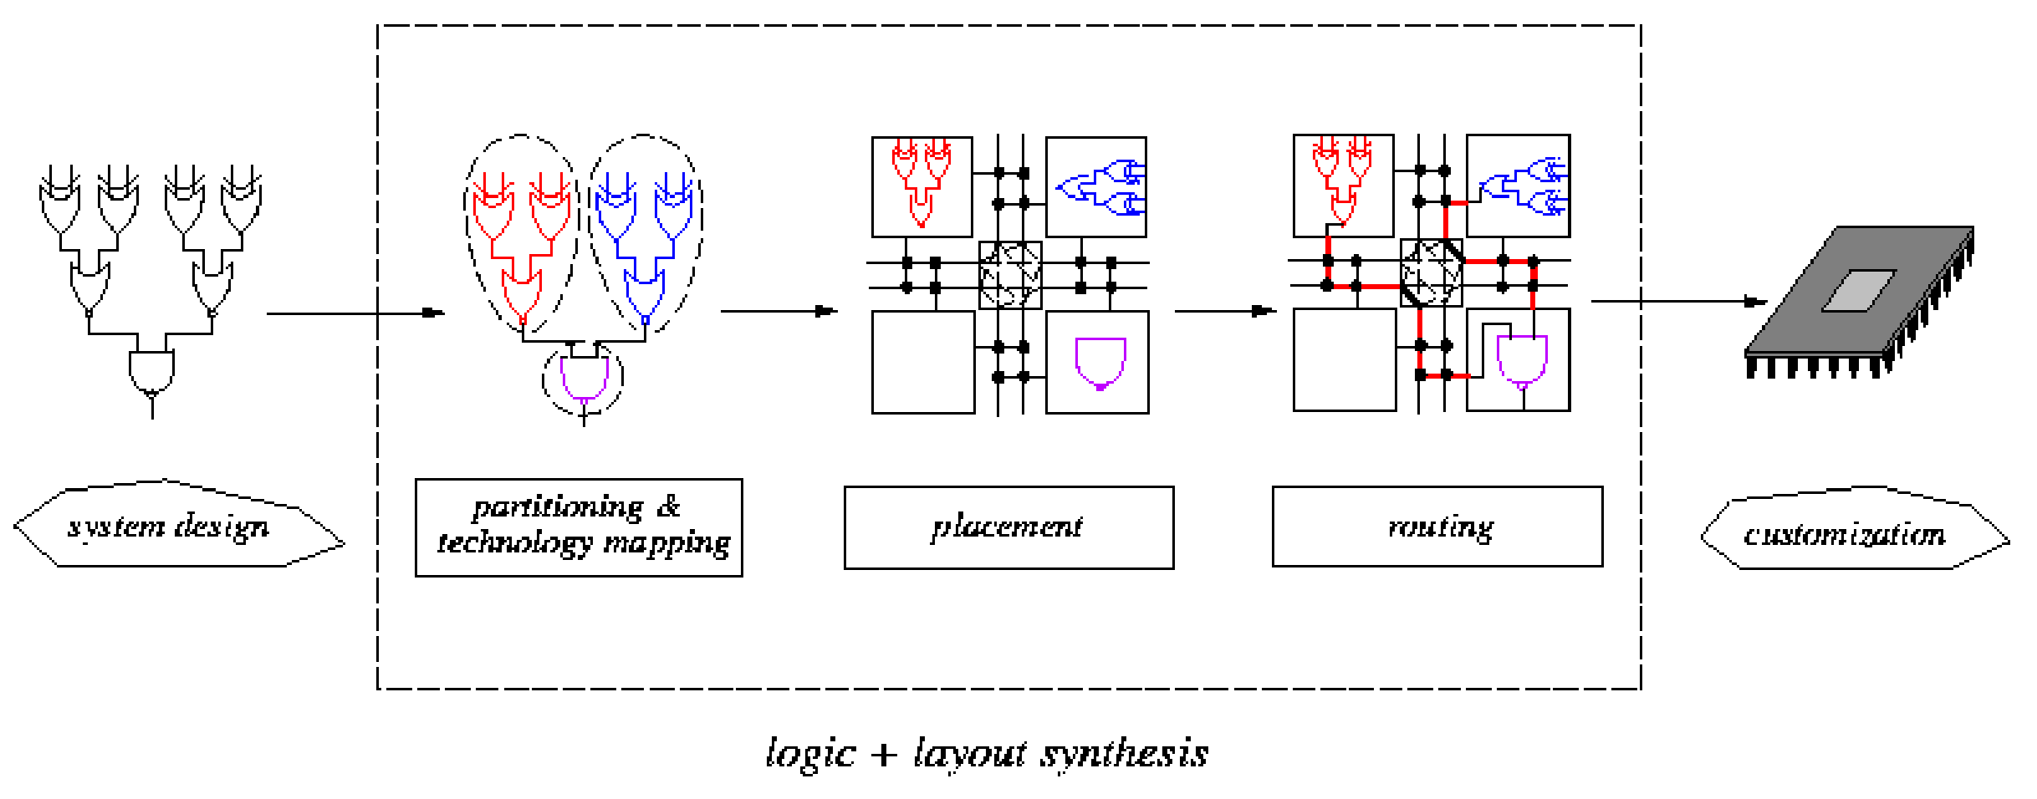
FPGA Placement & Routing

Slide 16
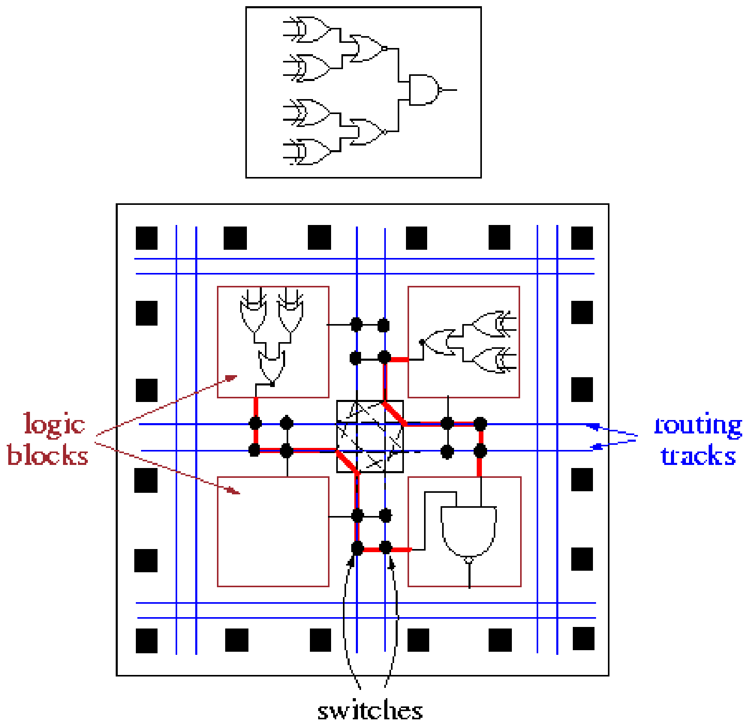
Field Programmable Gate Array (FPGA)

Slide 17
Modern FPGA Architecture
[Microprocessor]
Multipliers
Memory
Logic Cells

